Slide 1
University of Public Administration and Finance Ludwigsburg

Slide 2
at a Glance

Slide 3
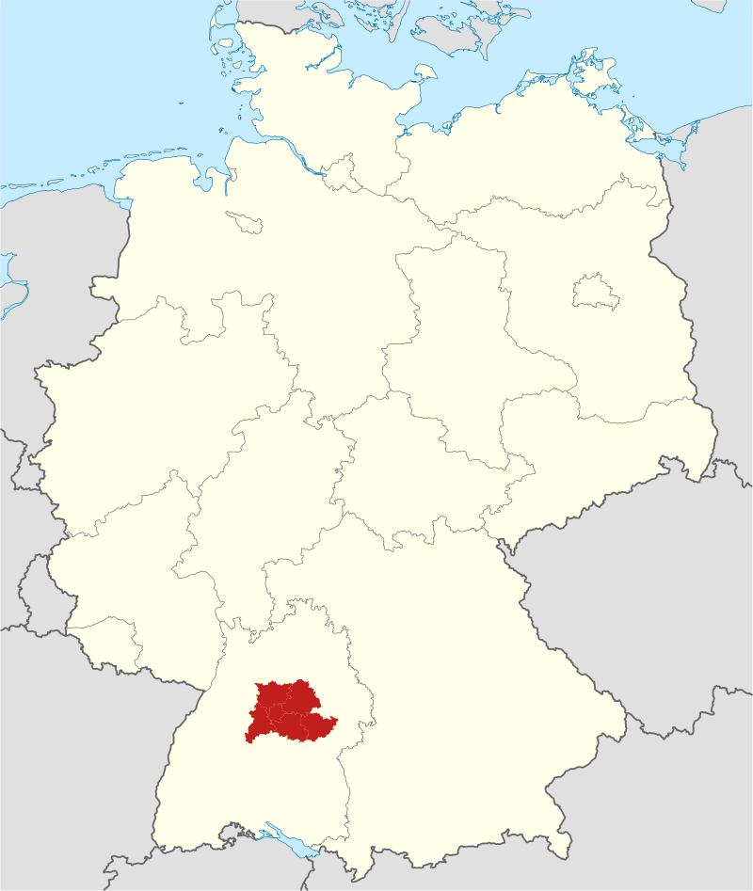
Ludwigsburg is part of the metropolitan area Stuttgart
= 5.3 mio. inhabitants
€ 149 billion GDP
Ludwigsburg
Stuttgart
Baden-Württemberg:
11 mio. inhabitants
part of the Rhine and Danube River Basins (= 266 resp 250 km length)

Slide 4
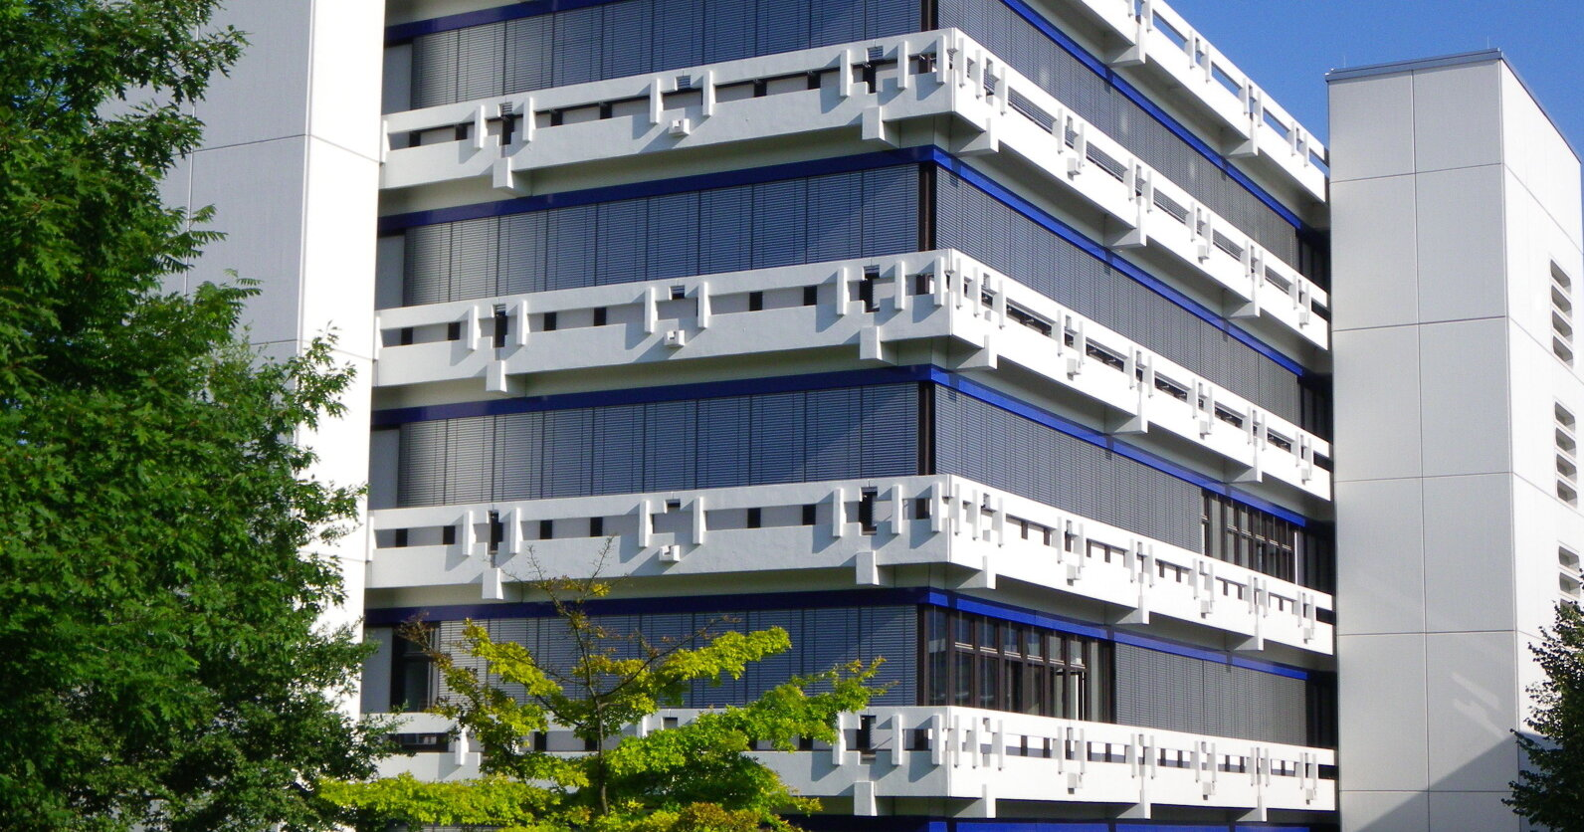
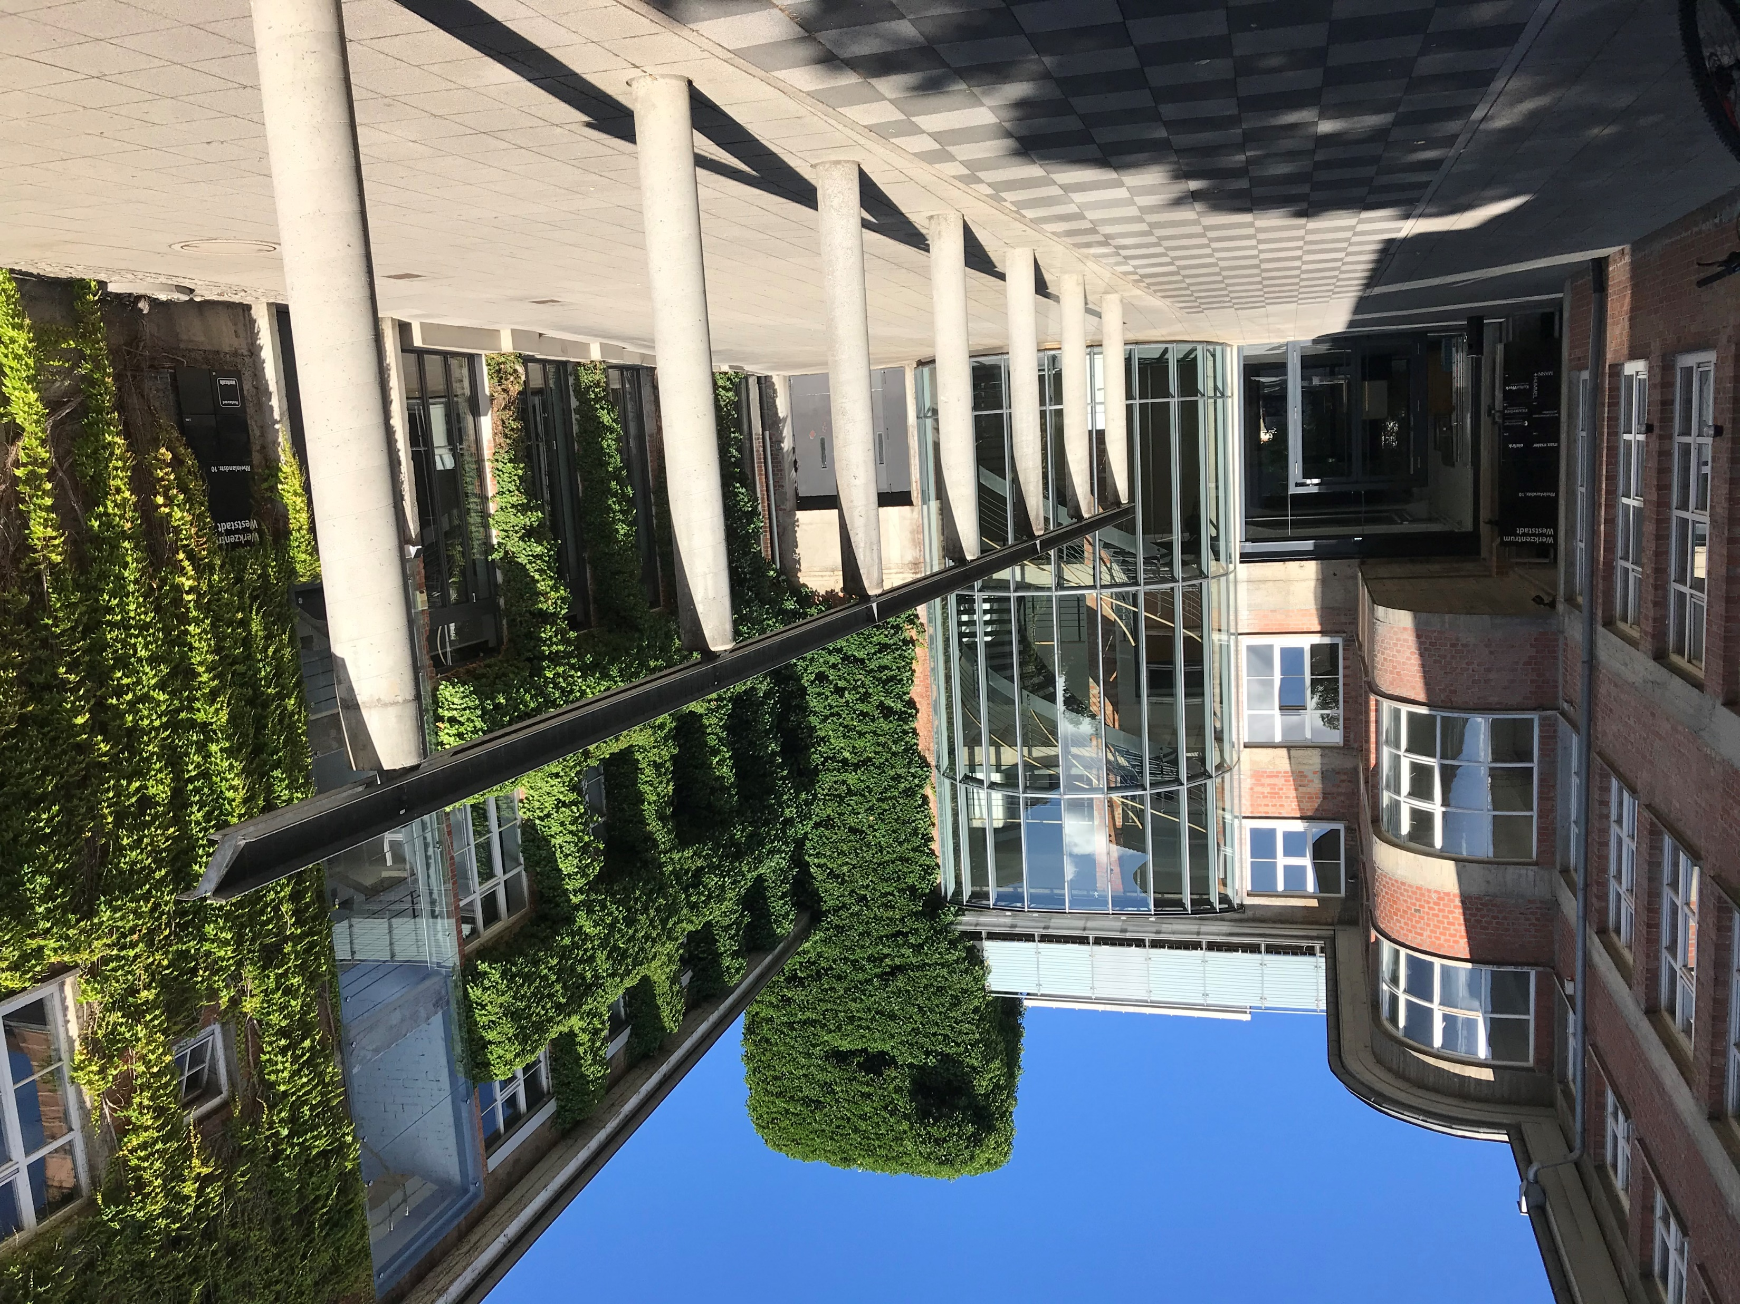
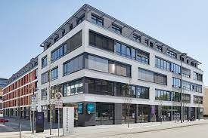
UAS Ludwigsburg
Main Location:
Campus Favoritepark: Public Management, Tax Administration, Rectorate, central administration, IT, library
Further Locations:
Bleyle Quarter: seminar rooms
Urban Harbor: Public Financial Management, Digitization of Public Administration, Pension Insurance, European Public Administration, Graduate School, Institute of Advanced Research

Slide 5
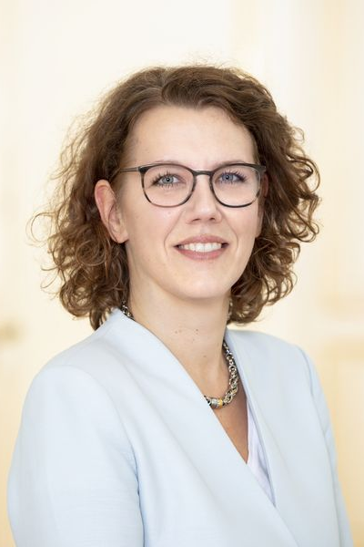
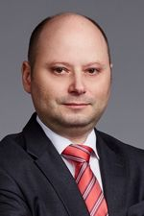
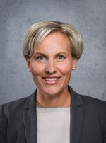
Managing Board
Dr. Iris Rauskala
Rector /President
Dr. Henrik Becker
Chancellor
Prof. Dr. Simone Wunderle
Vicerector for Studies and Teaching
Prof. Dr. Sascha Gieseler
Vicerector for Research, Continuing Education and Internationalization

Slide 6
Staff and Students
~ 600
(external) Lecturers
~ 90
Full Professors
app. 2,900
students
~ 95
Staff
^{Data: Summerterm 2023}

Slide 7
50 Years Jubilee on April 1st, 2023
1973: Foundation of UAS for Public Administration at Stuttgart
1979: Foundation of UAS for Finance at Ludwigsburg
1999: Merger of both UAS at Ludwigsburg, giving the largest UAS for Public Sector Studies in Baden-Württemberg
2023: New Website, Corporate Design and Claim: „Wissen. Wandel. Werte.“ (= Knowledge.Change.Values.)

Slide 8
uas FOR Public Sector Studies in Baden-Württemberg
Internal UAS (4)
Students of BA Studies gain access to specific public sector careers (6,980 Studierende).
Schwetzingen (Judical System)
(777 Students)
State Universities (9)
State Universities of Applied Sciences (19)
Ludwigsburg (2,912 Students)
Dual UAS BW (13)
Ludwigsburg (ca. 2.850 Studierende)
Teacher Training Colleges (6)
Kehl (General Public Administration) (1,366 Students)
Villingen-Schwenningen (Police) (1,925 Students)
Source: https://www.statistik-bw.de/BildungKultur/Hochschulen/HS-SO.jsp

Slide 9
Hochschulstandort Ludwigsburg
6.160 Studierende¹
2.912 Studierende¹
ca. 500 Studierende²
ca. 70 Studierende²
1.164 Studierende¹
¹⁾ Quelle: https://www.statistik-bw.de/BildungKultur/Hochschulen/HS-SO.jsp
(Letzter Aufruf: 27.03.2023; Stand: Wintersemester 2020/2021)
²⁾ Stand: Wintersemester 2022/2023

Slide 10
Studies and Teaching

Slide 11
Reasons for Studying at an Internal UAS
Meaningful jobs serving the public interest, high responsibility fot the common interest and our society
Certainty and security due to the „civil servant“-status right from the start of studies; Students get paid (as they are civil servant)
Clear perspecitve on the future job and proile, seamless transition into the job
Many opportuinies and career perspectives within the public sector

Slide 12
Faculties and Programmes
Master
Public Management
European Public Administration
Bachelor
Public Management
Pension Insurance
Tax Administration
Digitization of Public Administration
Public Financial Management
Faculty I –
Management and Law
Faculty II –
Tax- and Business Law

Slide 13
Bachelor Programmes
Tax Administration (Ministry of Finance BW) | Careerpath „gehobener Dienst der Steuerverwaltung“ App. 480 students per year Bachelor of Laws (LL.B.)
Public Management (communities) | Careerpath „gehobener Dienst der Innenverwaltung“ App. 350 students per year Bachelor of Arts (B.A.)
Public Financial Management (Ministry of Finance BW) | Careerpath „gehobener Dienst der Allgemeinen Finanzverwaltung“ ca. 60 students per year Bachelor of Laws (LL.B.)
Pension Insurance (Pension Insurance BW) | Careerpath „gehobener Verwaltungsdienst in der gesetzlichen Rentenversicherung“ App. 70 students per year Bachelor of Laws (LL.B.)
Digitization of Public Administration (local communities) | Careerapth „gehobener Dienst im digitalen Verwaltungsmanagement“ App. 25 students per year Bachelor of Arts (B.A.)
In cooperation with UAS Kehl
In cooperation with UAS Kehl

Slide 14
Bachelor „Public Management“ 2 EiNstieg in vielfältige Aufgabenbereiche
Knapp 90 % unserer Absolventinnen und Absolventen haben bereits vor Studienabschluss eine Stellenzusage!
Stand: Wintersemester 2022/2023

Slide 15
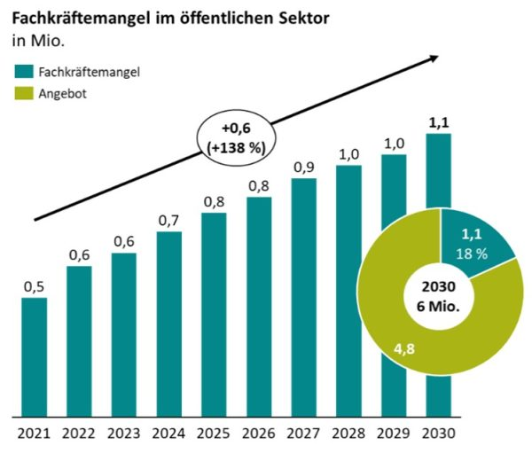
Skills Shortage in the Public Sector
By 2030, 1,1 Mio vacancies in the German Public Sector (not only for BW!)
Quelle: dbb beamtenbund und tarifunion (2021), Franke, Patrick (2022) und PwC (2022): Fachkräftemangel im öffentlichen Sektor.

Slide 16
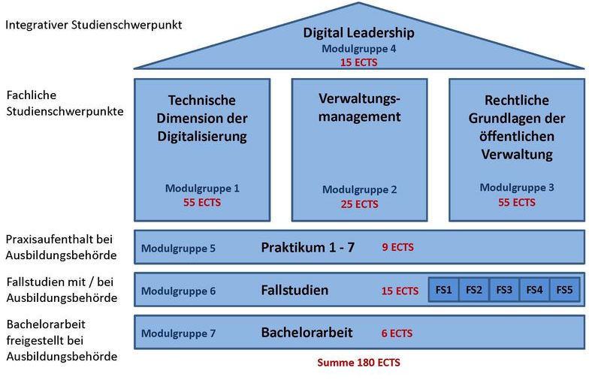
Bachelor „Digitales verwaltungsManagement“
Innovatives Studienkonzept seit Herbst 2020
Vier Studienschwerpunkte, ergänzt durch regelmäßige Praxiseinheiten in Verbindung mit zu bearbeitenden Fallstudien und Exkursionen:
Übergreifendes Themengebiet „Digital Leadership“
Technische Dimension der Digitalisierung
Verwaltungsmanagement
Rechtliche Grundlagen der öffentlichen Verwaltung

Slide 17
Faculties and Programmes
Master
Public Management
European Public Administration
Bachelor
Public Management
Pension Insurance
Taxadministration
Public Management Digitization
General Financial Administration
Faculty I –
Management and Law
Faculty II –
Tax- and Business Law

Slide 18
Master Programmes
Master of Public Management (MPM) | Aiming at management careers in the public sector 5 Semesters extra-occupational programme App. 25 students per year Master of Arts (M.A.)
Master European Public Administration (MEPA) | Aiming at entering a public sector career with an European perspective at local, state, federal or european level 4 Semesters consecutive programme App. 25 students per year Master of Arts (M.A.)

Slide 19
research and Transfer

Slide 20
Fields of Research and Transfer
Tax- / Financial Administration
Pension Insurance
Migration /Diversity
Social Law
Societal Change
100.000,-
3 Projekte
International Private Law
Finance and econonomic action
Aufstiegsfortbildung
Laufbahnqualifizierende Zusatzausbildung
(Traineeprogramm)
Kommunale/r Steuerexperte/in
Challenges with adaptation processes
Shaping the future of public sector administration
Kommunale als Steuerschuldnerin
Cultural Management
Interationalization / Globalization
Kommunale/r Bilanzbuchhalter/in
CeeeGovDays
IÖWR
BWL für die Justiz
Danube Region
Good Governance
Digitization and Work 4.0
Normsetzung
1 Tagesveranstaltung
25.000,-
3 Projekte
HRM
Arbeits- und Führungswelten der Zukunft
Local Government Administration
DD, Bürger-
beteiligung
Digital Transformation
Direkte Demokratie
Digital change in local government
Digitization

Slide 21
Research and Transfer Projects
Digital maturity of local governments of different sizes, as well as capacbility to innovate of local governemnts, agile organization cultures
Learning at work using digital agents (e.g. based on ChatGPT)
Evaluation of legal norms as well as giving reform options in the field of good governance

Slide 22
Promotionsmöglichkeiten an der HVF
Promotionsverband: Die HAWs in BW haben seit 2022 das Promotionsrecht
Promotionskollegs: Bereits davor gab es die Möglichkeit, mit Universitäten zu kooperieren; HVF ist Mitglied im Kooperativen Promotionskolleg „Good Administration“

Slide 23
Continuous education and further training

Slide 24
Life long learning
We want to offer conutinuous education and further training to our Alumni throughout their professional careerDie Weiterbildung findet an der HVF im LUCCA (Ludwigsburg Competence Centre of Public Administration) statt.
Focus on
Programmes relevant to the professional carreer (adcancement) and also to persons enterung the public sector later in their professional career
Tax Law, Accounting and Financial Reporting

Slide 25
Life Long Learning
At the moment, the following topics are being developed, meeting the challenges of state and local governement
Climate Change Manager
Mobility Manager
Cybersecurity Manager
Tax-Compliance Manager

Slide 26
Our Mission
As an internal university, europeanization and internationalization is not easy to achieve
However, we are looking for european good practice partners meeting our university profile or some of its aspects
The Danube Region is a clear priority to the state government of Baden-Württemberg
Relations along the Danube are already existing!

Slide 27
Wissen. Wandel. Werte.

